Slide 1





AndroNova ✨
ELEVATING FITNESS WITH EMOTIONS
A NEW PARADIGM IN PERSONALIZED WORKOUTS

Slide 2
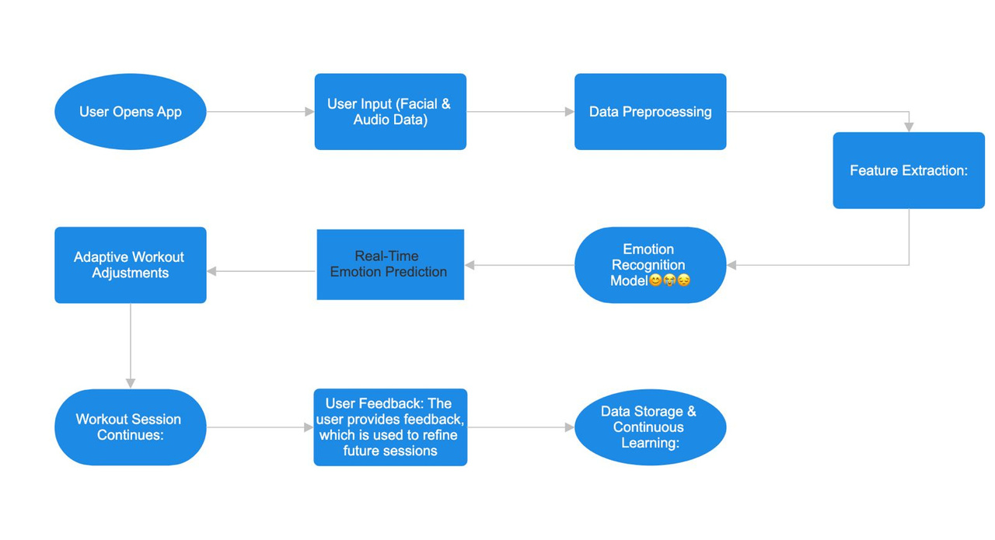
AndroNova ✨
TABLE OF CONTENT
03. Introduction
04. Problem Statement
05-06. Statistical Data
07. Proposed Solution
08-11. Technology Behind It
12-16. Technical Parameters
17. Target Audience
18. Scalability
19. Impact
20. Thank You [ Team ~AndroNova :) ]

Slide 3


AndroNova
INTRODUCTION TO
THE CONCEPT
Imagine a workout that knows exactly how you’re feeling—like a personal trainer who not only tracks your reps but also understands your mood, energy, and motivation. Our platform is built on the idea that fitness should be a holistic experience, seamlessly integrating your emotional state to optimize both mental and physical well-being

Slide 4



PROBLEM STATEMENT
AndroNova
Traditional fitness programs fundamentally fail to recognize the critical influence of emotional states on workout experiences, resulting in a disheartening disconnect between individual needs and fitness routines. This oversight leads to chronic inconsistency in motivation and engagement, causing many individuals to abandon their fitness journeys altogether. Consequently, the effectiveness and sustainability of these programs suffer, leaving countless people trapped in a cycle of frustration and unmet goals. The pressing need for truly personalized wellness experiences that address emotional well-being has never been clearer.

Slide 5
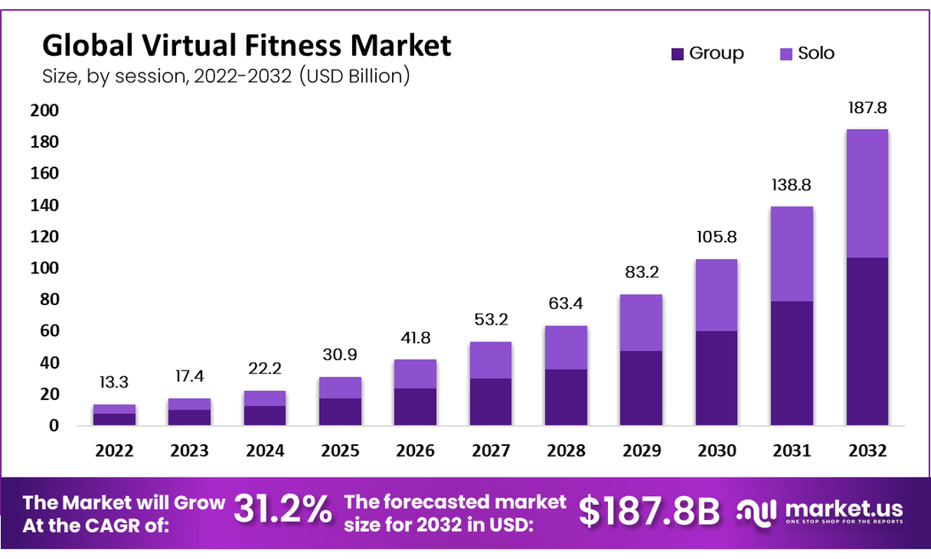
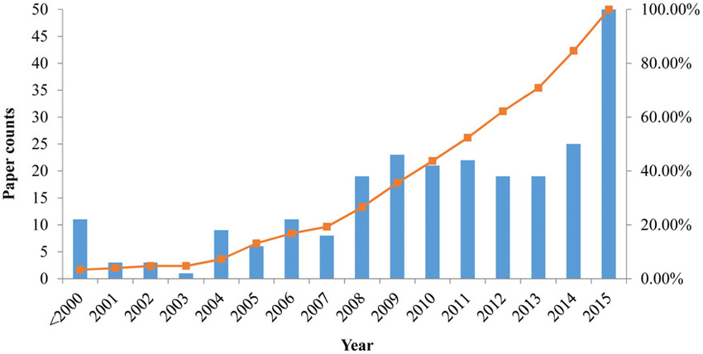
AndroNova
STATISTICS ACROSS THE YEARS
The global fitness industry was valued at approximately $96.7 billion in 2021 and is projected to reach $135 billion by 2028, growing at a CAGR of 6.9%.
The usage of fitness apps increased by 50% during the COVID-19 pandemic, with a global user base exceeding 1.1 billion in 2022.
According to the WHO, the global prevalence of anxiety and depression increased by 25% during the first year of the pandemic.
Studies show that regular exercise can reduce symptoms of depression by 30%, and anxiety by up to 20%.

Slide 6
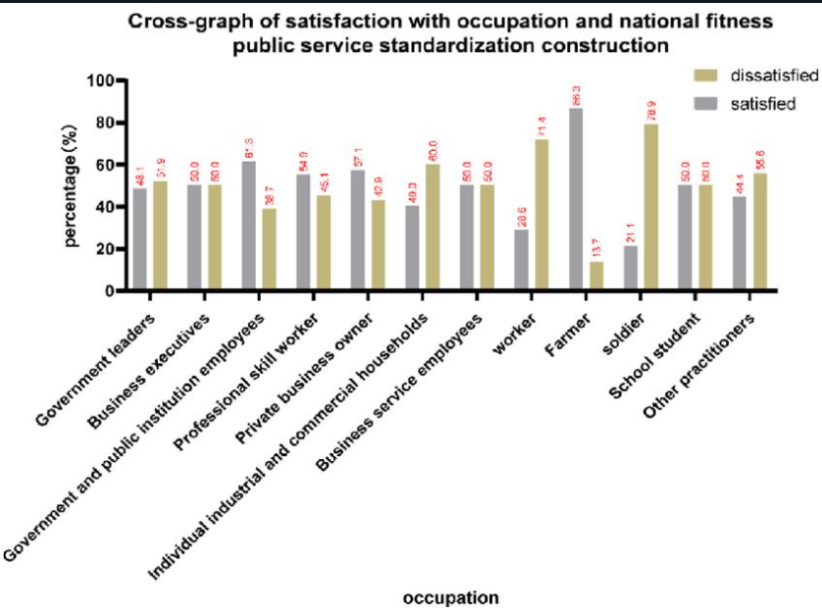
AndroNova
STATISTICS OF DISSATISFACTION
Global Average Satisfaction: This line would show the overall satisfaction trend over time.
Regional Trends: Separate lines for regions such as North America, Europe, Asia, etc., could highlight regional differences.
Type of Workouts: Different lines or bars could represent satisfaction for specific workout types like yoga, HIIT, strength training, etc.
According to a 2020 survey by the American College of Sports Medicine (ACSM), 70% of fitness professionals reported that mental wellness programs, including stress management and mindfulness, were a top trend in the fitness industry.

Slide 7


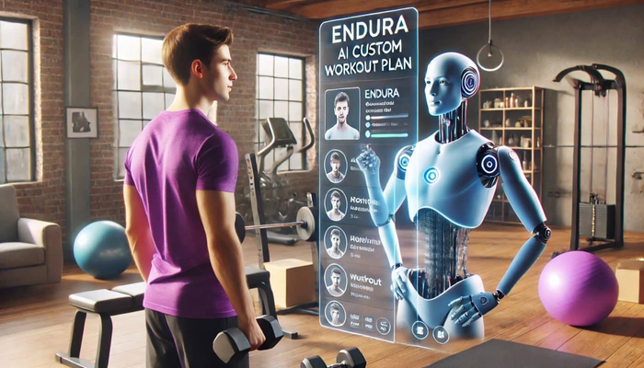


Proposed solution:
AndroNova
What We Offer:
EMOTION-DRIVEN AI
The platform integrates cutting-edge AI to analyze real-time emotional data—such as facial expressions and voice tones—during your workouts
How It Works:
The platform intelligently adapts your fitness routine, offering motivational boosts when you're low on energy or calming sessions when you need to unwind. This ensures each workout is perfectly tailored to your mood
Benefits :
By aligning your physical and emotional states, enhances workout consistency, improves overall mental well-being, and creates a sustainable fitness journey that's truly unique to you

Slide 8


AndroNova
TECHNOLOGY BEHIND IT !
Emotion-Driven AI
Adaptive Fitness Routines
At the core of our platform is advanced AI technology that decodes real-time emotional data, including facial expressions, voice tones, and body language. This allows us to create a fitness experience that’s truly personalized
Based on your emotional state, our AI adjusts your workout in real-time—whether guiding you to a relaxing yoga session or pushing you to new limits, ensuring your routine always matches your needs.

Slide 9
AndroNova
TECHNOLOGY BEHIND IT ! (CONTD.)
Data Preprocessing
Facial Expression Data (FER2013)
Audio Data (RAVDESS & EMO-DB)
Images are resized, normalized, and augmented to enhance the model's ability to detect emotions from various angles and lighting conditions.
Audio clips are converted into spectrograms, with noise reduction applied to improve clarity for emotional analysis.

Slide 10
AndroNova
TECHNOLOGY BEHIND IT ! (CONTD.)
Feature Extraction
Facial Features
Audio Features
CNNs extract key facial features, focusing on areas like the eyes and mouth, critical for emotion recognition.
Audio clips are converted into spectrograms, with noise reduction applied to improve clarity for emotional analysis.

Slide 11

AndroNova
TECHNOLOGY BEHIND IT ! (CONTD.)
Model Training
Visual Emotion Recognition
Audio Emotion Recognition
A fine-tuned CNN model classifies emotions based on facial features.
LSTM networks analyze temporal audio patterns, understanding how emotions evolve in speech.
Integration
Inference
Real-Time Implementation
The trained models process live facial and audio data during workouts, predicting emotional states in real-time.
The AI dynamically adjusts workouts based on emotional insights, ensuring a personalized experience.

Slide 12

AndroNova
Technical Parameters for Data Collection
AUDIO PARAMETERS
Audio Quality and Clarity
Emotional Range Detection
Voice Activity Detection (VAD)
Sampling Rate

Slide 13
AndroNova
Technical Parameters for Data Collection
VISUAL PARAMETERS
Facial Landmark Detection
Lighting Conditions
Expression Intensity Measurement
Frame Rate

Slide 14
AndroNova
Technical Parameters for Data Collection
PHYSIOLOGICAL DATA PARAMETERS
Heart Rate Variability (HRV)
Body Temperature
Respiratory Rate

Slide 15
AndroNova
Technical Parameters for Data Collection
CONTEXTUAL DATA PARAMETERS
Environmental Factors
Time of Day and Circadian Rhythms
Monitoring external factors like ambient noise, room temperature, or lighting conditions to adjust the workout environment for optimal comfort and performance.
Incorporating data on the user’s circadian rhythm or time of day to optimize workout timing and intensity based on natural energy levels and emotional states.

Slide 16
AndroNova
Technical Parameters for Data Collection
SOCIAL DATA PARAMETERS
Social Interaction Cues
Community Engagement
85% of users reported feeling more motivated during virtual group sessions.
70% expressed a preference for mixed workout formats (both solo and group).
75% of users stated that seeing peers’ progress motivated them to push harder.
65% of users participated in group challenges, noting enhanced accountability
Peer Influence
80% of users preferred creating personalized challenge groups rather than joining generic ones.
55% reported higher engagement when challenges were tailored to their fitness levels.

Slide 17

AndroNova
TARGET AUDIENCE
Fitness Enthusiasts and Athletes
Busy Professionals
Primarily aged 18-45
Aged 25-50
Tech-Savvy Millennials and Gen Z
Aged 18-35
Mental Health and Wellness Seekers
Rehabilitation and Recovery Patients
Individuals aged 18-35

Slide 18
SCALABILITY
AndroNova
Our platform is designed for seamless growth, leveraging cloud infrastructure to handle increasing user demand without sacrificing performance. With modular AI components, we ensure continuous improvement and the ability to expand features effortlessly.
To scale our user base, we implement a freemium model to attract users and corporate partnerships to expand rapidly through collaborations with wellness programs and gyms. Our AI and data capabilities grow with big data integration for enhanced personalization and cross-platform integration with wearables and other fitness apps.
For global expansion, we focus on localized features to cater to regional preferences and strategic partnerships with fitness brands to accelerate market entry.

Slide 19
IMPACT
AndroNova
The emotional disconnect in traditional fitness programs leads to a staggering 67% of individuals reporting a lack of motivation, ultimately resulting in over 50% dropping out within the first six months. This disheartening trend not only hinders personal health and wellness but also contributes to a broader societal issue of declining physical and mental well-being. By integrating emotional intelligence into fitness routines, we can transform the landscape of wellness, fostering sustained engagement and motivation. This shift not only empowers individuals to achieve their fitness goals but also promotes a healthier, more resilient society. Addressing the emotional aspect of fitness is not just an enhancement but a fundamental necessity for lasting change in personal health and community well-being.

Slide 20

AndroNova ✨
THANK YOU!
Team Members:
Aayush Kumar
Nalin Vijayvargiya
Krish Kumar
Bhavashesh Dachapalli
Yasharth Kesarwani

